Slide 1

Healthcare Data Challenge Intro to data Science
Aneesa Abbasi, Toon Rouws, Haroun Salman, Tamoor Ali, Marley Werleman
Introduction into Data Science

Slide 2



Slide 3
TABLE OF CONTENTS
01
04
02
05
03
Background
Solution
Introduction
Recommendations
Data Science

Slide 4


Slide 5
17.9 million each year
BACKGROUND
85% due to heart attacks
Notes:
CVDs are the number 1 cause of death globally: more people die annually from CVDs than from any other cause. An estimated 17.9 million people died from CVDs in 2016, representing 31% of all global deaths. Of these deaths, 85% are due to heart attack and stroke.

Slide 6
Problem Definition
"How to predict future risk of heart disease based on current symptoms and habits?"

Slide 7
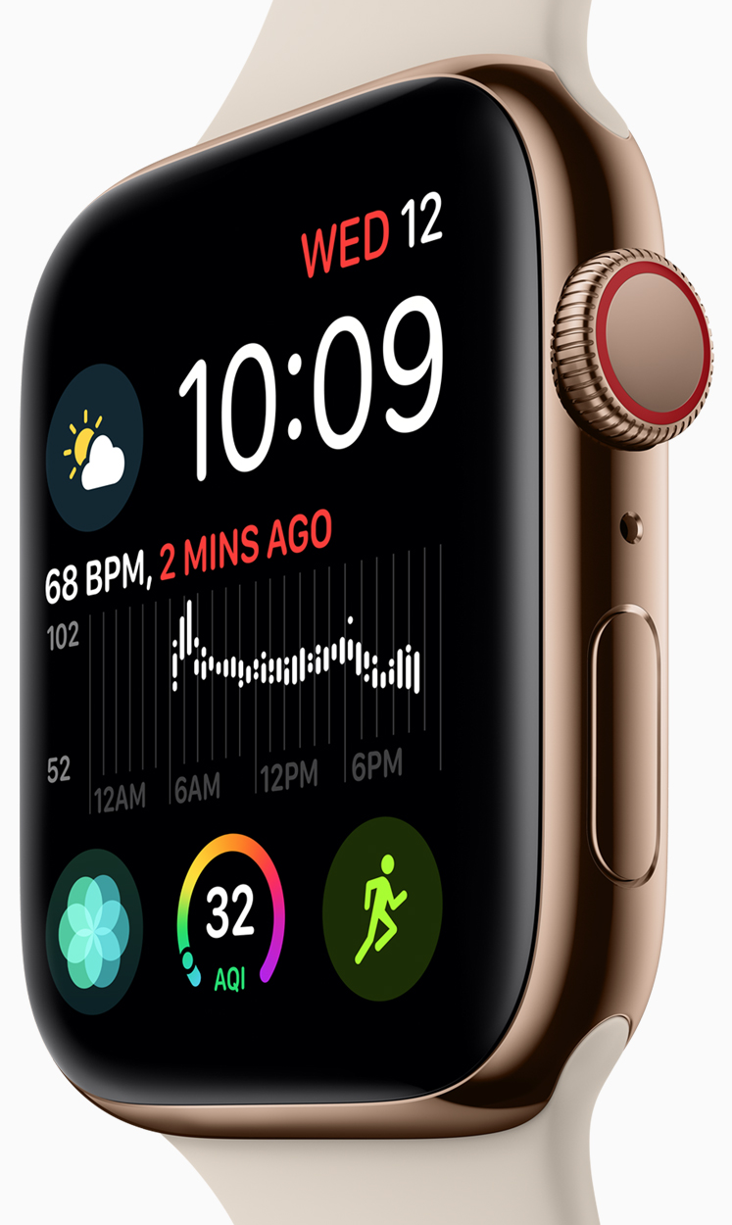
Product (SOLL)
A health monitoring device with ML algorithm to predict the heart failure risk

Slide 8
Stakeholders
Health insurer
Medical doctor Supplier
Hospital Data Scientist
High Power, Low Interest
High Power, High Interest
Power of stakeholders
Health Government
Patient General Practitioner
Low Power, Low Interest
Low Power, High Interest
Interest of stakeholders
Notes:
Mendelow map

Slide 9
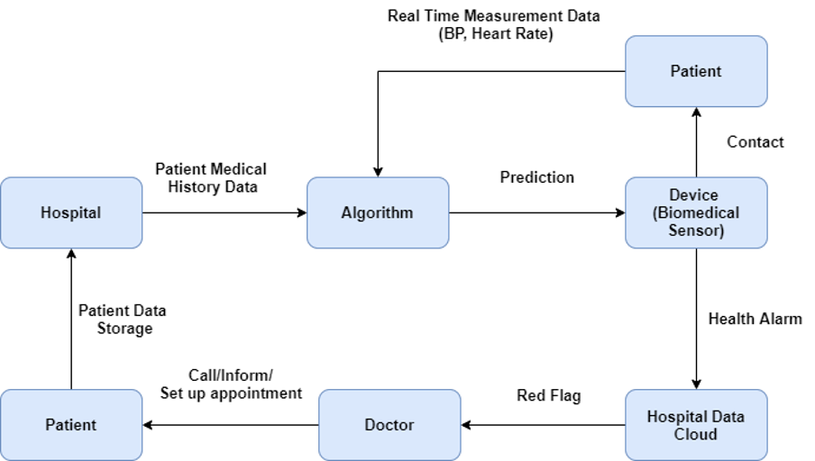
Architecture (SOLL)

Slide 10
Healthcare data value chain
Brainstorming Understanding and defining the problem. Identifying the stakeholder. Impact of the results. GOAL
Modeling and clustering Predictions and profiling
Exploratory data analysis Understanding the data types , correlations, insights
Data product Service, Dashboards, api Deployment

Slide 11
DATASCIENCE
HEART DISEASE PREDICTION MODEL
Cleveland database since 1988
Selected features: 14
Datapoints: Around 1100
5 team members....
Notes:
Contributors and donors of the data:
Hungarian Institute of Cardiology. Budapest: Andras Janosi, M.D.
University Hospital, Zurich, Switzerland: William Steinbrunn, M.D.
University Hospital, Basel, Switzerland: Matthias Pfisterer, M.D.
V.A. Medical Center, Long Beach and Cleveland Clinic Foundation: Robert Detrano, M.D., Ph.D.
Donor: David W. Aha (aha '@' ics.uci.edu) (714) 856-8779

Slide 12
Data Features
Age
sex
chest pain type (4 values)
resting blood pressure
serum cholestoral in mg/dl
fasting blood sugar > 120 mg/dl
resting electrocardiographic results (values 0,1,2)
maximum heart rate achieved
exercise induced angina
oldpeak = ST depression induced by exercise relative to rest
the slope of the peak exercise ST segment
number of major vessels (0-3) colored by flourosopy
thal: 3 = normal; 6 = fixed defect; 7 = reversable defect
Notes:
ge
sex
chest pain type (4 values)
resting blood pressure
serum cholestoral in mg/dl
fasting blood sugar > 120 mg/dl
resting electrocardiographic results (values 0,1,2)
maximum heart rate achieved
exercise induced angina
oldpeak = ST depression induced by exercise relative to rest
the slope of the peak exercise ST segment
number of major vessels (0-3) colored by flourosopy
thal: 3 = normal; 6 = fixed defect; 7 = reversable defect

Slide 13
Assumptions
General - Data is collected randomly - The dataset from the Cleveland hospital would be similar to the same dataset for the fictional dutch hospital Domain - cholesterol, age, sex and bloodpressure are important features

Slide 14
Exploratory Data Analysis
Multivariate correlation matrix
Box plot for target class
Scatter plots for feature relationship
One hot encoding
Normally distributing features for sample analysis
Basic statistical information analysis (SweetViz)

Slide 15
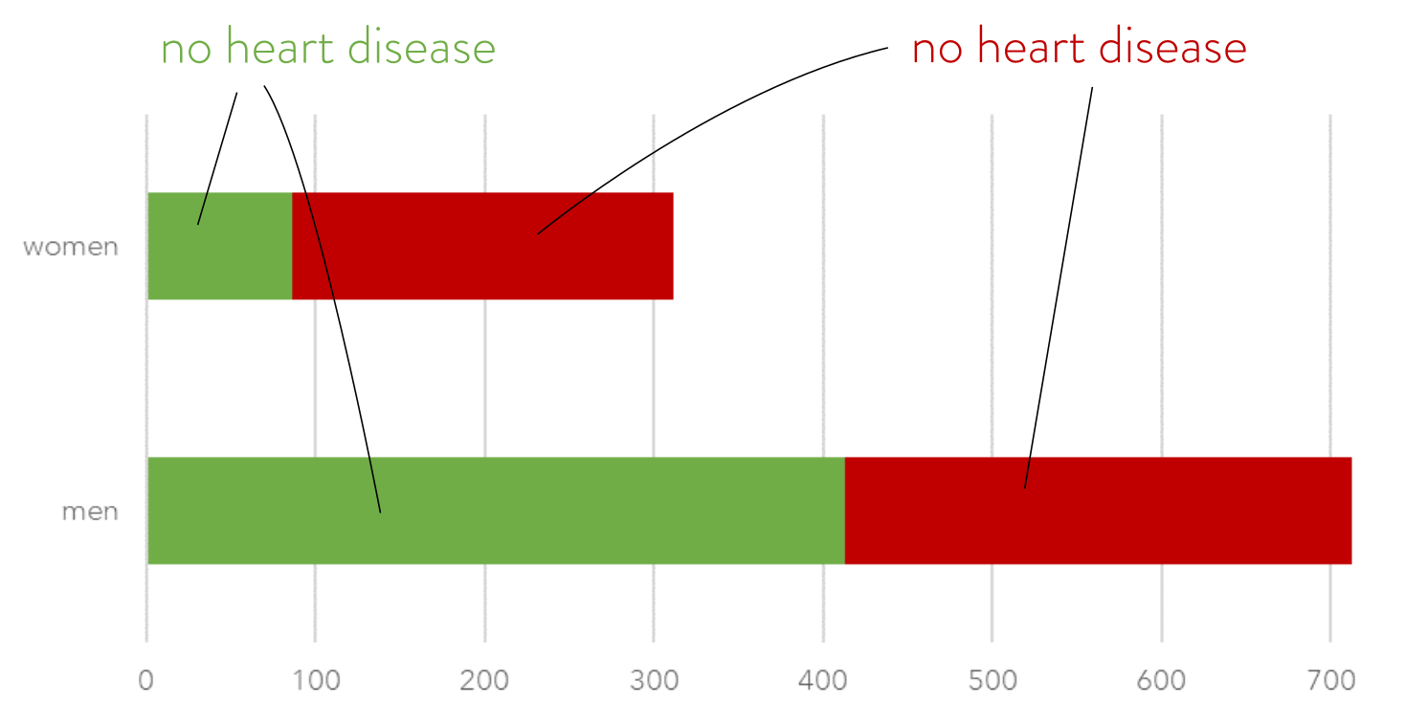
Exploratory Data Analysis: composition dataset
300 of 713 men (42%)
226 of 312 women (72%) have heart disease

Slide 16
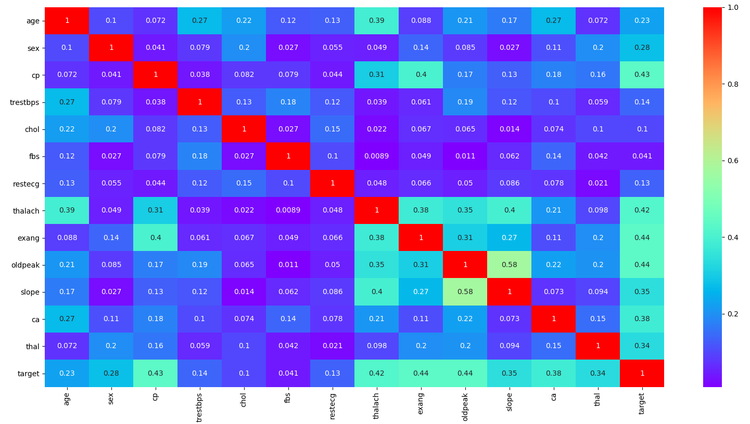
Exploratory Data Analysis: correlation (absolute)

Slide 17
Exploratory Data Analysis: correlation (absolute)

Slide 18
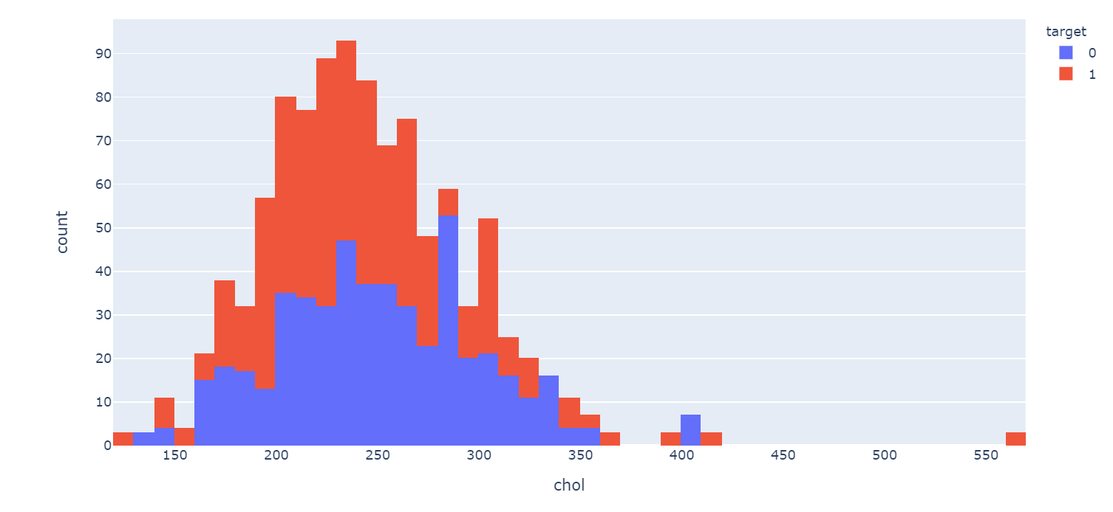
Exploratory Data Analysis
Patients with heart disease and cholestrol ratio
Although cholesterol (240>) seems an indicator for getting a heart disease. There is no correlation between cholesterol and people (male ánd female) that get a heartdisease (target=1)

Slide 19
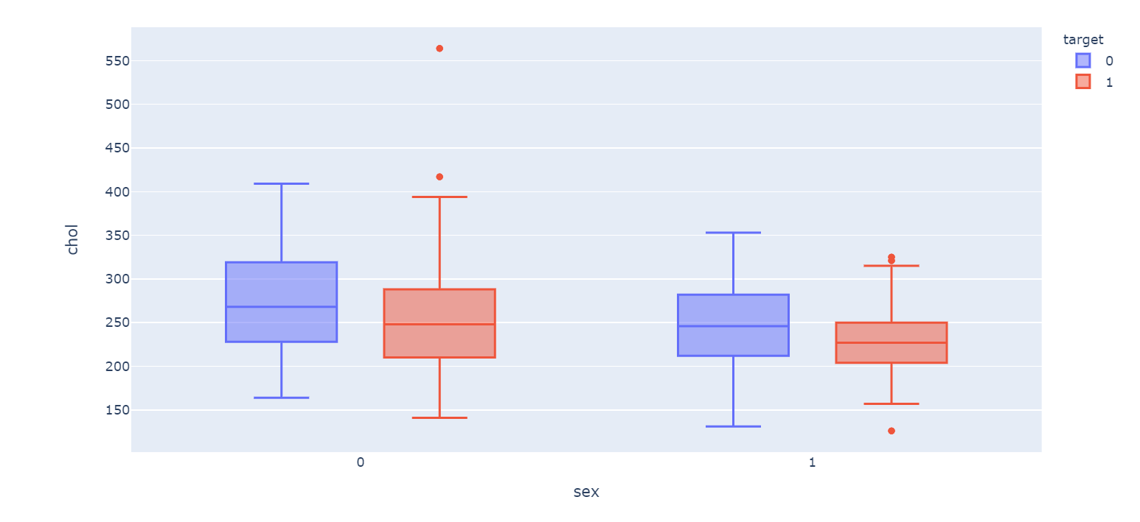
Exploratory Data Analysis
Male/Female ratio with chol and heart disease

Slide 20
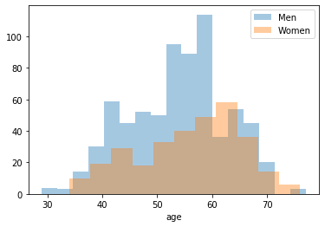
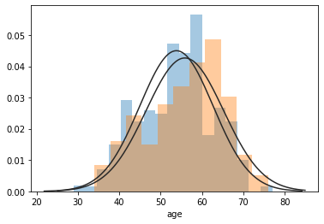
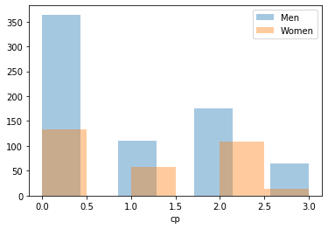
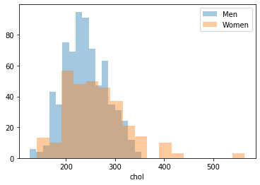
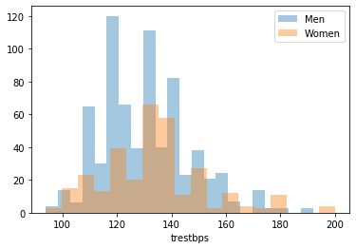
Exploratory Data Analysis: Feature Comparisons

Slide 21
Exploratory Data Analysis
For all the heart patients (people with heart disease) men between 40-45 and 50-60 are majority. For women the distribution with age is not as observable.
Notes:
Assumption "Midlife crisis"

Slide 22
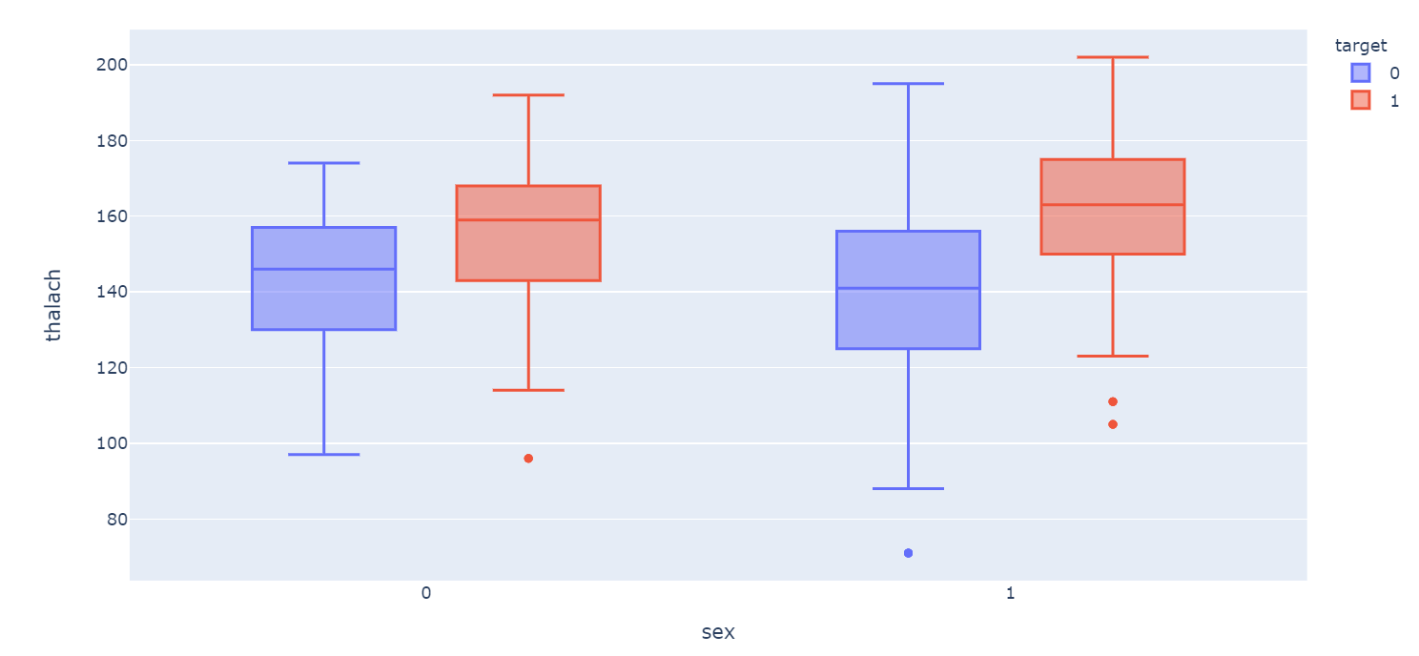
Exploratory Data Analysis
People with a higher thalach (maximum hart rate), have a bigger chance of getting a heart attack.

Slide 23
Classification Techniques
KNearestNeighbor
Random Forest
SVM
Decision Trees
Logistic Regression
XGBoost

Slide 24
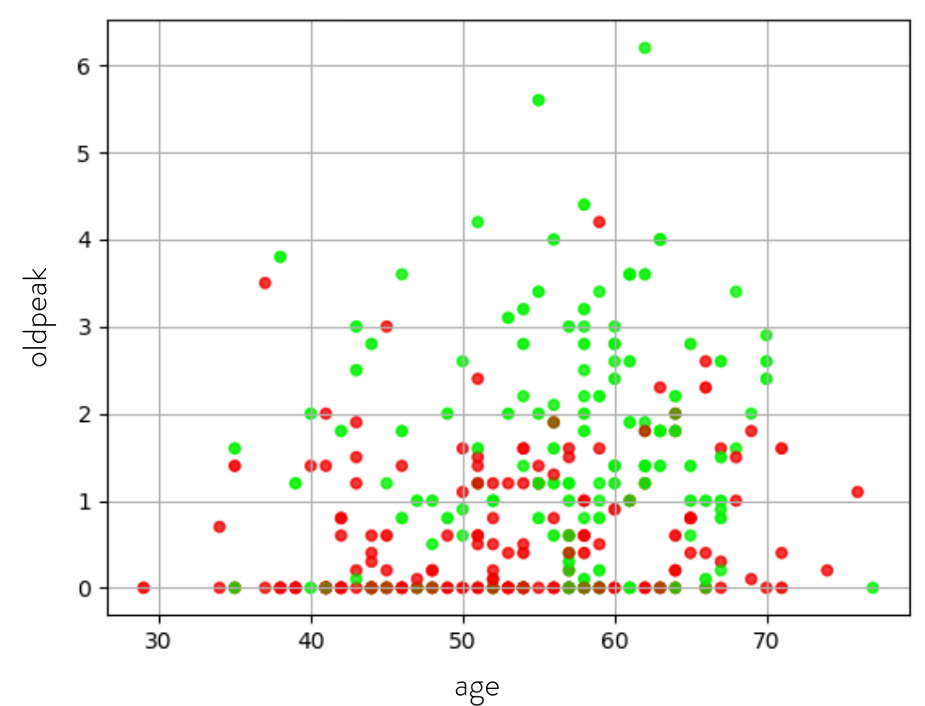
Heart Disease and Oldpeak

Slide 25
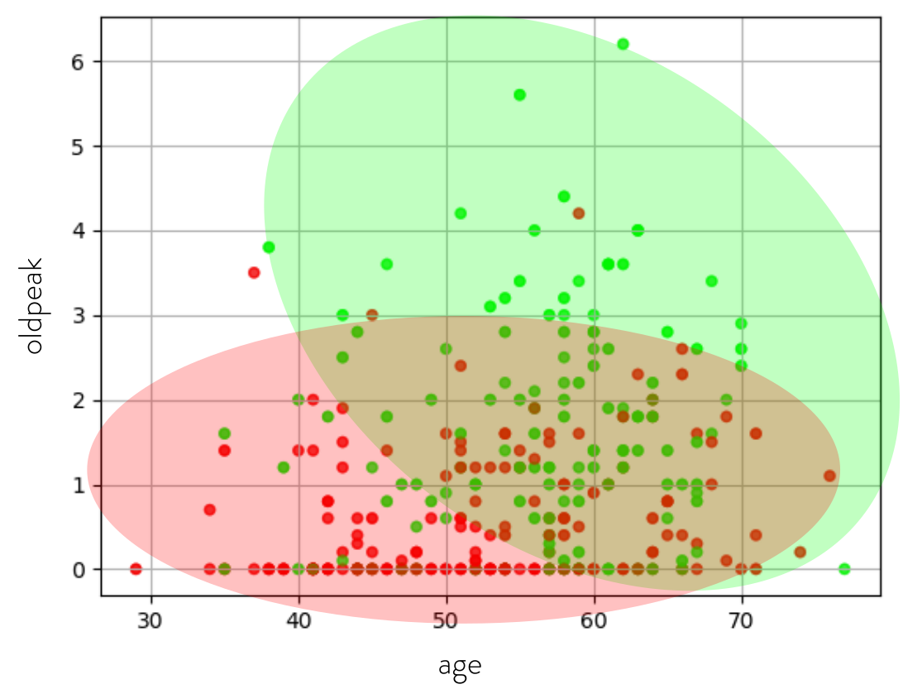
Heart Disease and Oldpeak

Slide 26
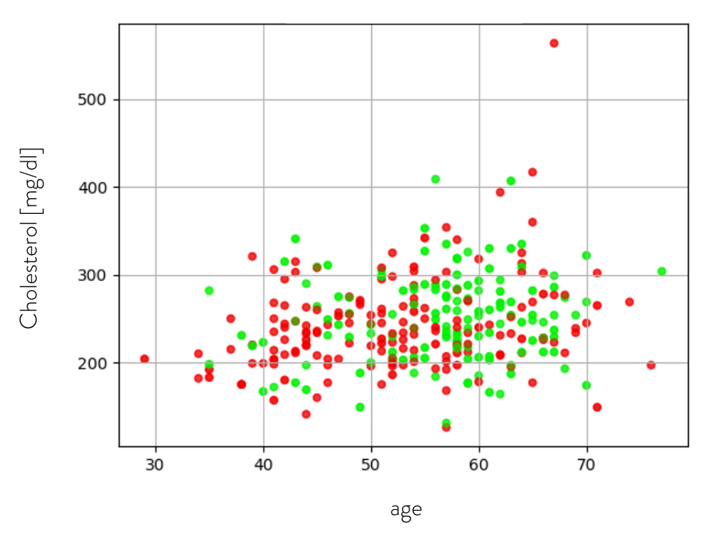
Cholesterol vs. Age

Slide 27
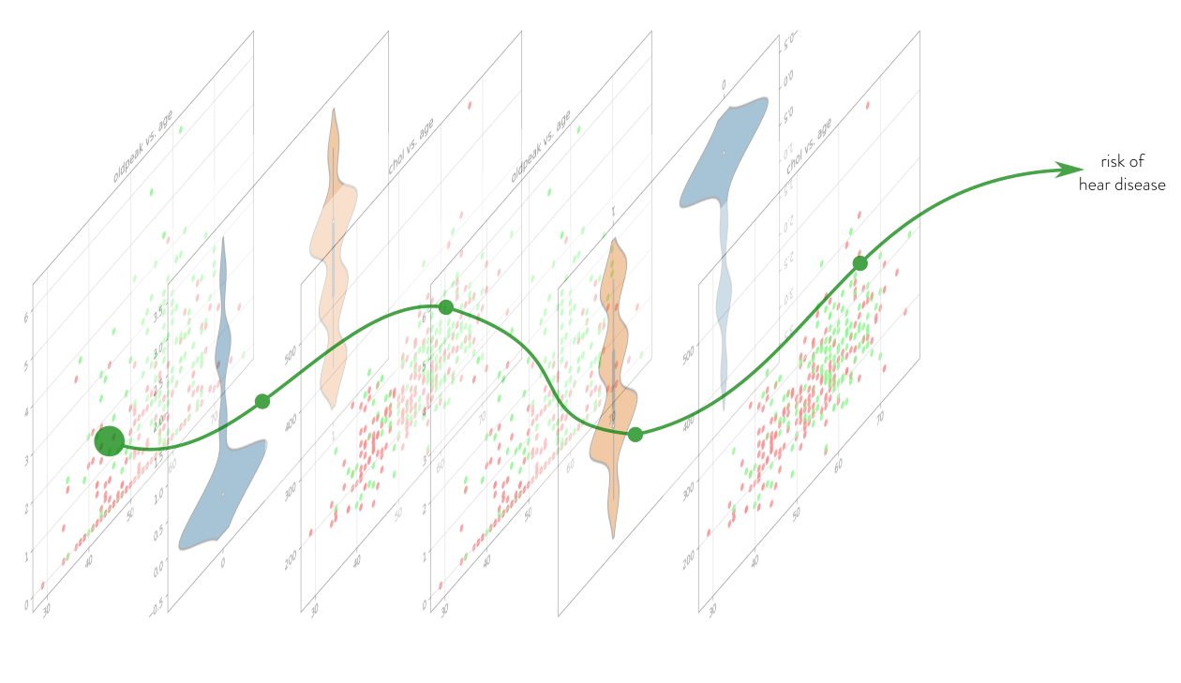
Logistics Distribution

Slide 28
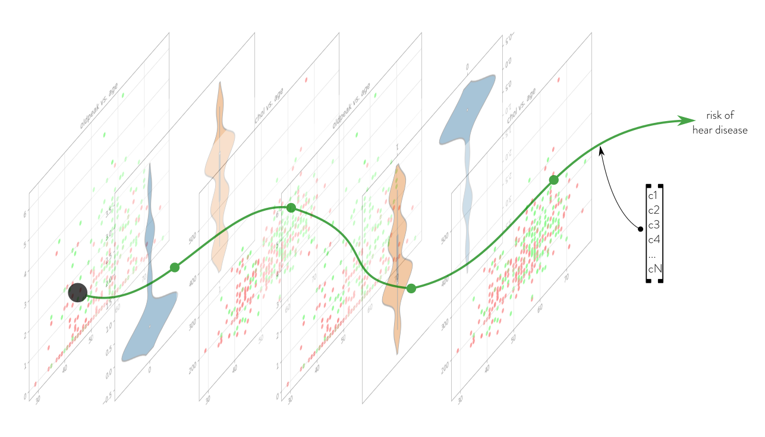
Logistics Distribution

Slide 29
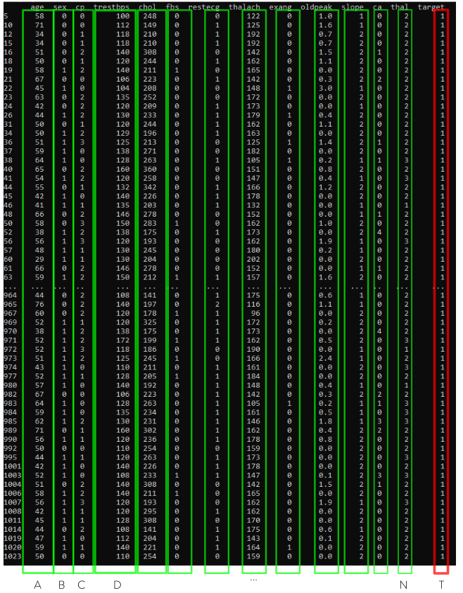

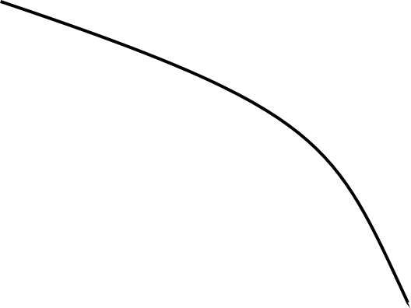


Slide 30
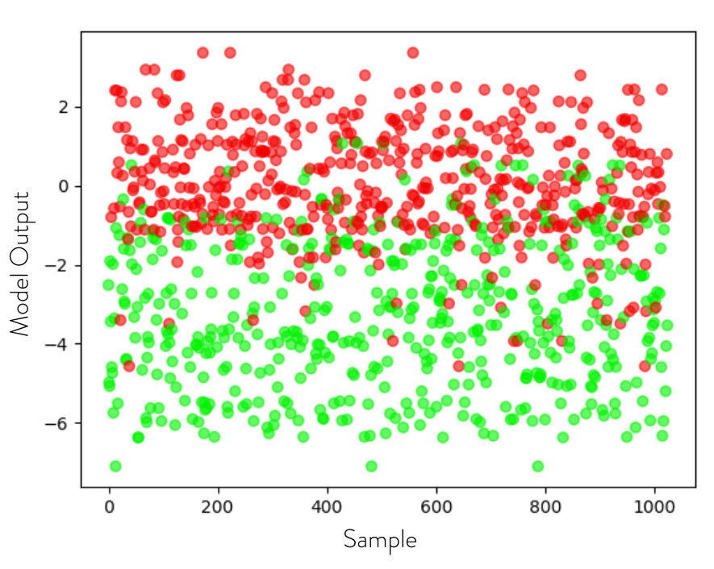

Slide 31
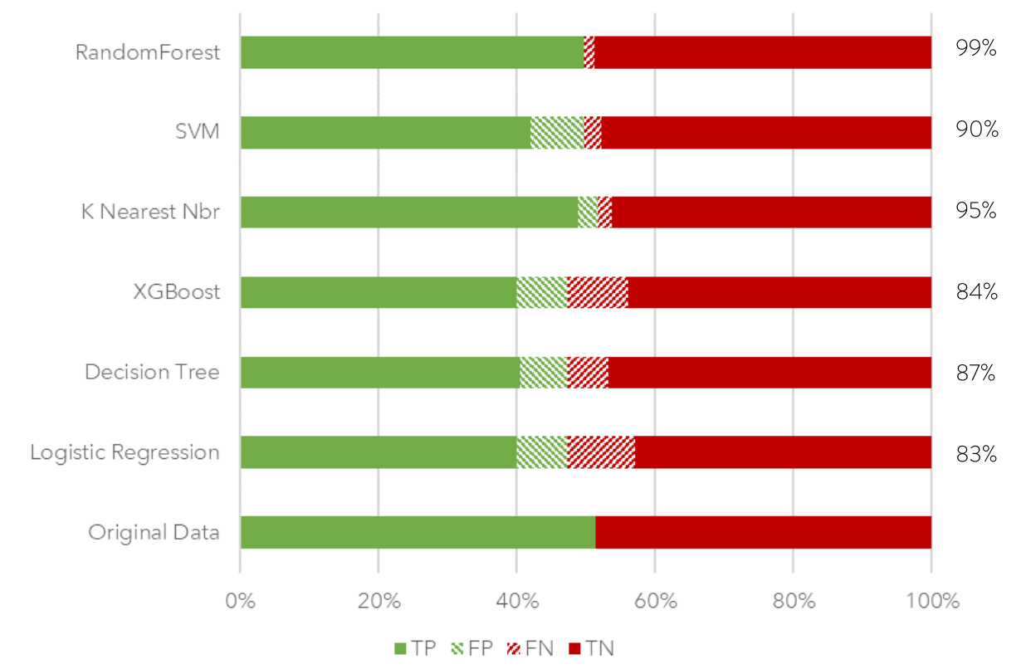
Results

Slide 32
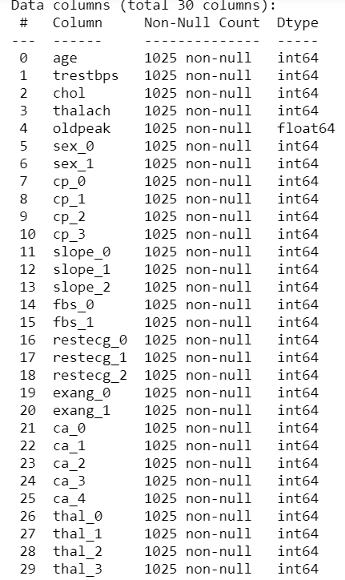
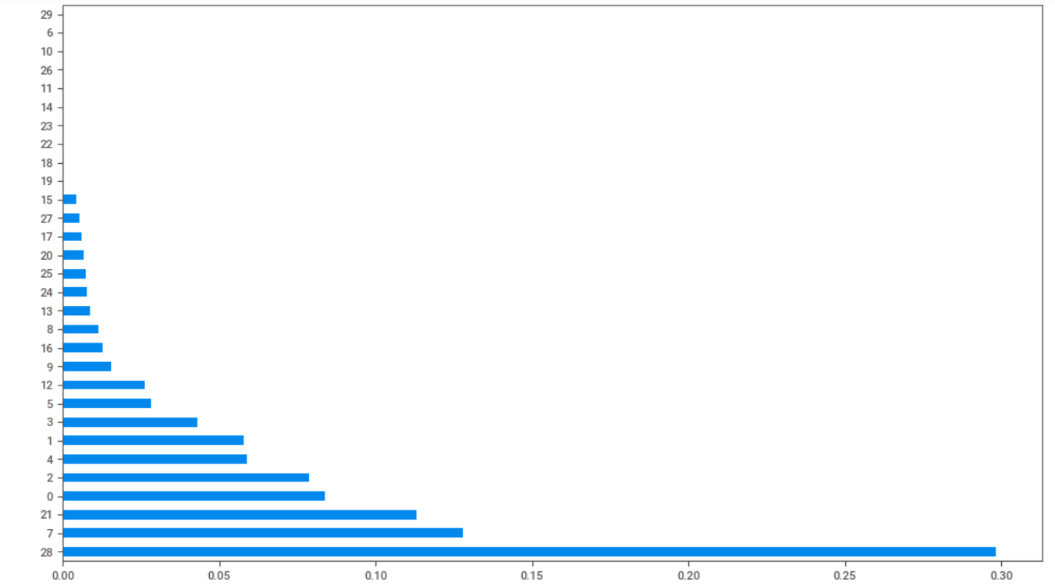
Feature importance
Most important features
- thal = 2
- chestpain type = 0
- number of major vessels = 0
- age
- cholesterol

Slide 33
Future Work
1. Insight in the following data:
i) economic data - smokers - income
ii) patient data - weight - BMI - date and time of different datapoints
2. Supplement the current data with continious data from a medical device

Slide 34





Solution Demonstration
Alarm
Patient’s Medical Data
Prediction
Patient
Patient’s Medical History Database
Alarm
ML Algorithm
Device
Doctor

Slide 35
THANKS
Does anyone have any questions?

